Slide 1
The chemicals in our clothes
Christina Lowenthal & Andrew Shepherd

Slide 2
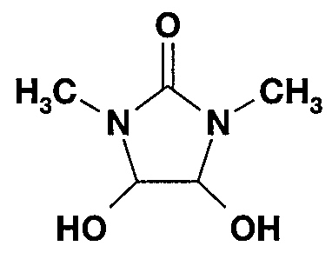
What is formaldehyde?
Formaldehyde is a chemical that is used widely across many products in our environment.
Formaldehyde is the simplest aldehyde and is also known as methanal.
It is a colorless gas at room temp, with a distinctive, pungent and irritating odor.

Slide 3
Where can it be found?
Fabrics treated with formaldehyde resins and in which some free formaldehyde remains. Formaldehyde resins provide the unique qualities of the following fabrics:
Permanent press
Anti-cling, anti-static, anti-wrinkle and anti-shrink finishes
Chlorine-resistant finishes
Stiffening on lightweight nylon knits
Waterproof finishes
Perspiration proof finishes
Moth proof and mildew resistant finishes
Suede and chamois

Slide 4
Where it can be found cont.
Cosmetics and toiletries including fingernail polishers and hardeners, antiperspirants, makeup, bubble bath, bath oils, shampoos, creams, mouthwashes and deodorants. In many cases formaldehyde is used as a preservative.
Household cleansers, disinfectants and polishes
Paper products — formaldehyde is used to improve the water resistance, grease resistance, shrink resistance and other characteristics of paper
Building materials — urea-formaldehyde glue or adhesive is used in pressed wood products such as particle board, plywood and MDF (medium density fiberboard)
Medications including wart remedies, anhidrotics, medicated creams, orthopedic casts and root canal preparation disinfectant
Paints, primers and paint-stripping agents
Embalming fluid and as a preservative for laboratory specimens
Formaldehyde is released in the smoke from burning wood, coal, charcoal, cigarettes, natural gas and kerosene

Slide 5
Skin Reactions to formaldehyde
Reactions to formaldehyde depend on the type of exposure that has occurred. Formaldehyde is not only a sensitizer but also a potent primary irritant. Exposure to formaldehyde gas may cause burning sensations in the eye, nose and throat, skin rashes, tightness of the chest and wheezing, fatigue and headaches. These symptoms may be a result of a primary irritant effect or an allergic sensitization to formaldehyde.
Frequent or prolonged exposure may cause hypersensitivity, leading to the development of allergic contact dermatitis. This may occur through skin contact with formaldehyde containing products or with clothing made from fabrics containing formaldehyde. Dermatitis caused by clothing tends to affect parts of the body where there is greatest friction between the skin and fabric, for example "trouser dermatitis" is usually apparent on the inner thighs, gluteal folds and backs of the knees. Sweating may also be a factor in causing the allergic dermatitis as sweat or sebum appears to leach free formaldehyde from formaldehyde resins. Individuals sensitive to formaldehyde are not necessarily hypersensitive to formaldehyde resins. Clothing dermatitis appears to affect women more than men.
In individuals who are highly sensitive, contact with minute amounts of formaldehyde or being in a room where a bottle of formaldehyde may have been open previously thus leaving residual gas, can cause dermatitis.

Slide 6
Let’s take a closer look into the effects of this chemical and others found in clothing we wear on a daily basis…

Slide 7

Reactions in children: A major cause for concern
Finding residues of hazardous chemicals in clothing is a case for concern – especially if the clothing is made for children: infants and children may be more sensitive to the effects of some hazardous chemicals compared to adults. This is already reflected in some voluntary standards as well as in the restrictions that some textiles companies set for themselves, with more protective limits for concentrations of certain chemicals in clothing items for children, compared to adult clothing. It is also recognized in the restrictions on the presence of certain phthalates in toys and articles for children under three in the EU and other countries, which do not apply to clothing.

Slide 8
How it Affects the body
Hazardous chemicals have the potential to cause a range of adverse health effects. Some may interfere with the hormones (endocrine system).
Hazardous chemicals have the potential to cause adverse health effects.
Many hazardous chemicals are known to accumulate in our bodies; some of these have known hazardous properties and the potential to cause adverse health effects.
The use of hazardous chemicals in children’s clothing leads to the release of such chemicals into the environment, either during manufacturing or from the products directly.

Slide 9
Affects cont.
In some instances, there may also be the potential risk of direct exposure to these hazardous chemicals for children.
Many of the chemicals found are known endocrine disruptors, or (in the case of NPEs (Nonylphenol ethoxylates) are able to give rise to chemicals which are endocrine disruptors – chemicals which can interfere with hormone systems in animals and humans.
A recent UNEP & WHO report on endocrine disruptors concluded that some can act at very low doses and that the timing of some impacts on hormone systems can be critical.
Many endocrine-related diseases and disorders are on the rise (though in many cases the extents to which exposure to endocrine disruptors are contributing is still unclear)

Slide 10
Examples of Affects
Early puberty~ females before age 10 and males before age 12. Early activation of hormones and their receptors.
Lowered immune system
Fertility problems~ Females inability to conceive and males reproductive organs developed abnormally
Nervous system~ these chemicals are neurotoxins, which destroy nervous tissue. They can block synaptic transmissions by competitively combining to active sites. Activates processes that normally wouldn’t occur due to normal transmitter being unavailable.

Slide 11
Little monsters in your closet…

Slide 12
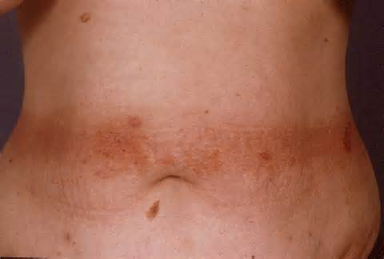
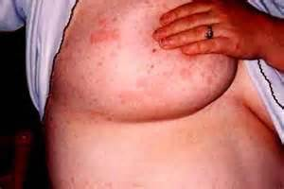
What it looks like
Common irritation where clothing rubs against the body.
On breast tissue from bras containing formaldehyde

Slide 13
Victoria’s secret…
Not much of a secret anymore.

Slide 14
How the body eliminates toxins
Liver ~ filtering system
Urine
Breath
Sweat
Bowels

Slide 15

What can you do to protect yourself?
Wash your clothes BEFORE wearing.
Purchase products that don’t contain formaldehyde or other chemicals.
Do your own research on products and companies.

Slide 16
References
http://www.greenpeace.org/eastasia/Global/eastasia/publications/reports/toxics/2013/A%20Little%20Story%20About%20the%20Monsters%20In%20Your%20Closet%20-%20Report.pdf
http://www.dermnetnz.org/dermatitis/formaldehyde-allergy.html
http://www.consumeraffairs.govt.nz/for-consumers/goods/product-safety/formaldehyde-in-clothing
https://www.youtube.com/watch?v=LoVcOHVagtc
https://www.youtube.com/watch?v=c-YQ9qCYulc

